Slide 1
6. Acid rain
GE002

Slide 2
You need to be able to….
Explain acid rain and its impacts on organisms, rocks and metals.

Slide 3
Which is incorrect?
Carbon + Oxygen water + carbon dioxide
Nitrogen + oxygen nitrogen dioxide
Sulphur + oxygen sulphur dioxide
Hydrocarbon + oxygen water + carbon dioxide

Slide 4
Why?
Carbon + Oxygen water + carbon dioxide X
Nitrogen + oxygen nitrogen dioxide
Sulphur + oxygen sulphur dioxide
Hydrocarbon + oxygen water + carbon dioxide

Slide 5
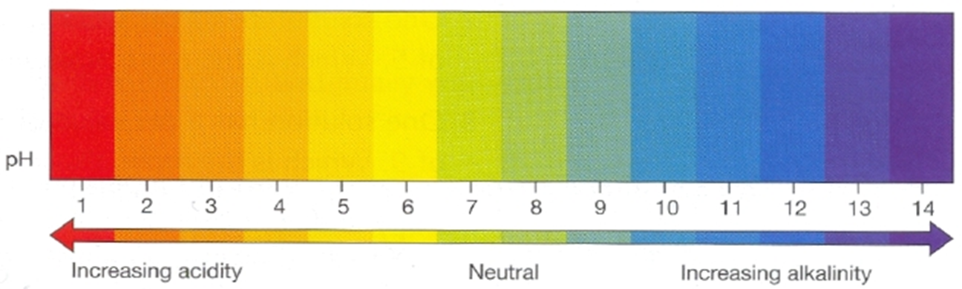
Which is the odd one out?
pH 2 pH5 pH7 pH8

Slide 6
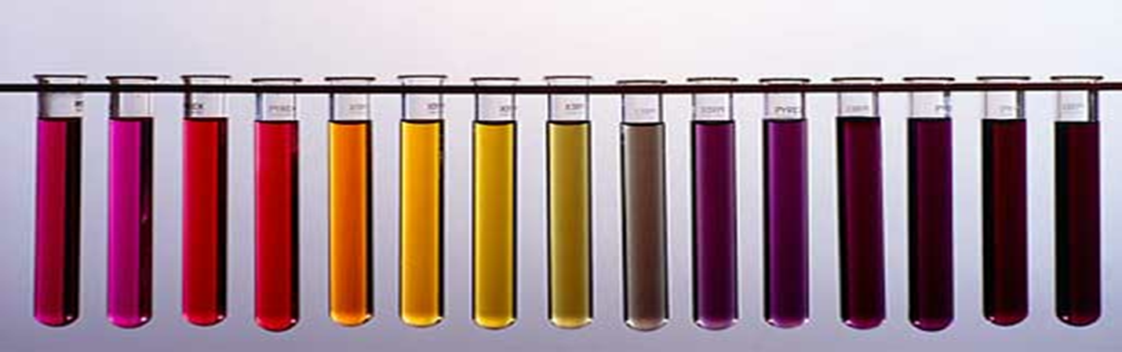
Which letter represents pH 4? A B C D

Slide 7
What does “emissions” mean?
To let gases in.
waste gases as a result of combustion.
Waste fuel.
Greenhouse gases.

Slide 8
What does “emissions” mean?
To let gases in.
waste gases as a result of combustion. ✓
Waste fuel.
Greenhouse gases.

Slide 9

State the meaning of acid deposition
“Acid” Rain is… Normal?
Rain water is naturally acidic with a pH of around 5.6
When surface water evaporates into the atmosphere (water cycle!) the water reacts with carbon dioxide in the air to form carbonic acid
Water + carbon dioxide → carbonic acid
Carbonic acid isn’t a very strong acid, so this isn’t very dangerous

Slide 10

State the meaning of acid deposition
Acid Deposition
Acid deposition is a broad term for any rain, snow, hail, fog, and even dust that has a pH of less than 5.6, caused by natural and human activity
Acid deposition is not caused from carbon dioxide, but due to sulfur dioxide and nitrogen oxides
Acid deposition can have dangerous effects on living systems and human infrastructure

Slide 11
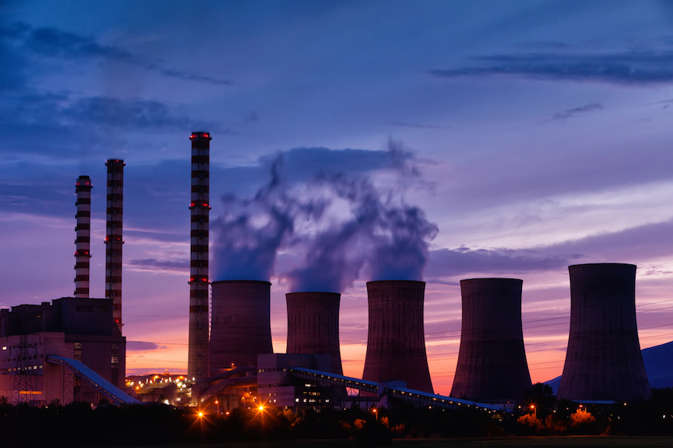
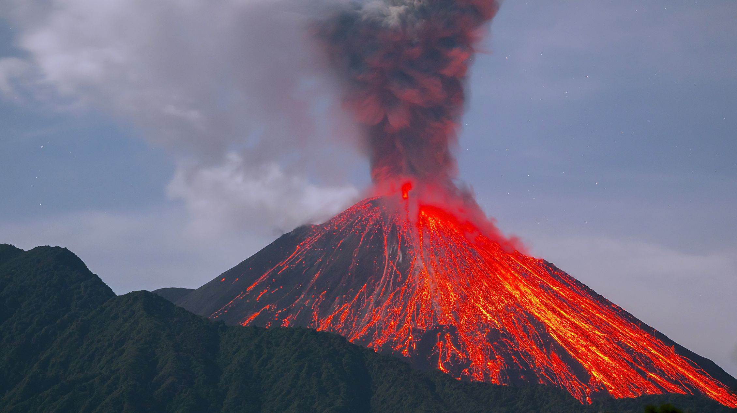
Reflect on the cause and effect of acid deposition by the actions of humans
Sulfur dioxide, SO₂
When sulfur dioxide reacts with water in the atmosphere it forms sulfuric acid
Sulfur dioxide is produced by coal power plants and volcanic eruptions

Slide 12
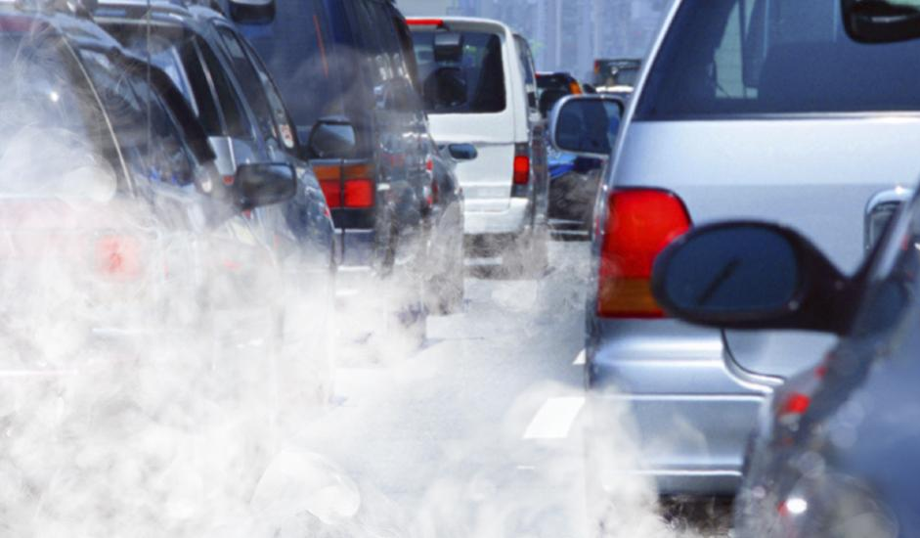
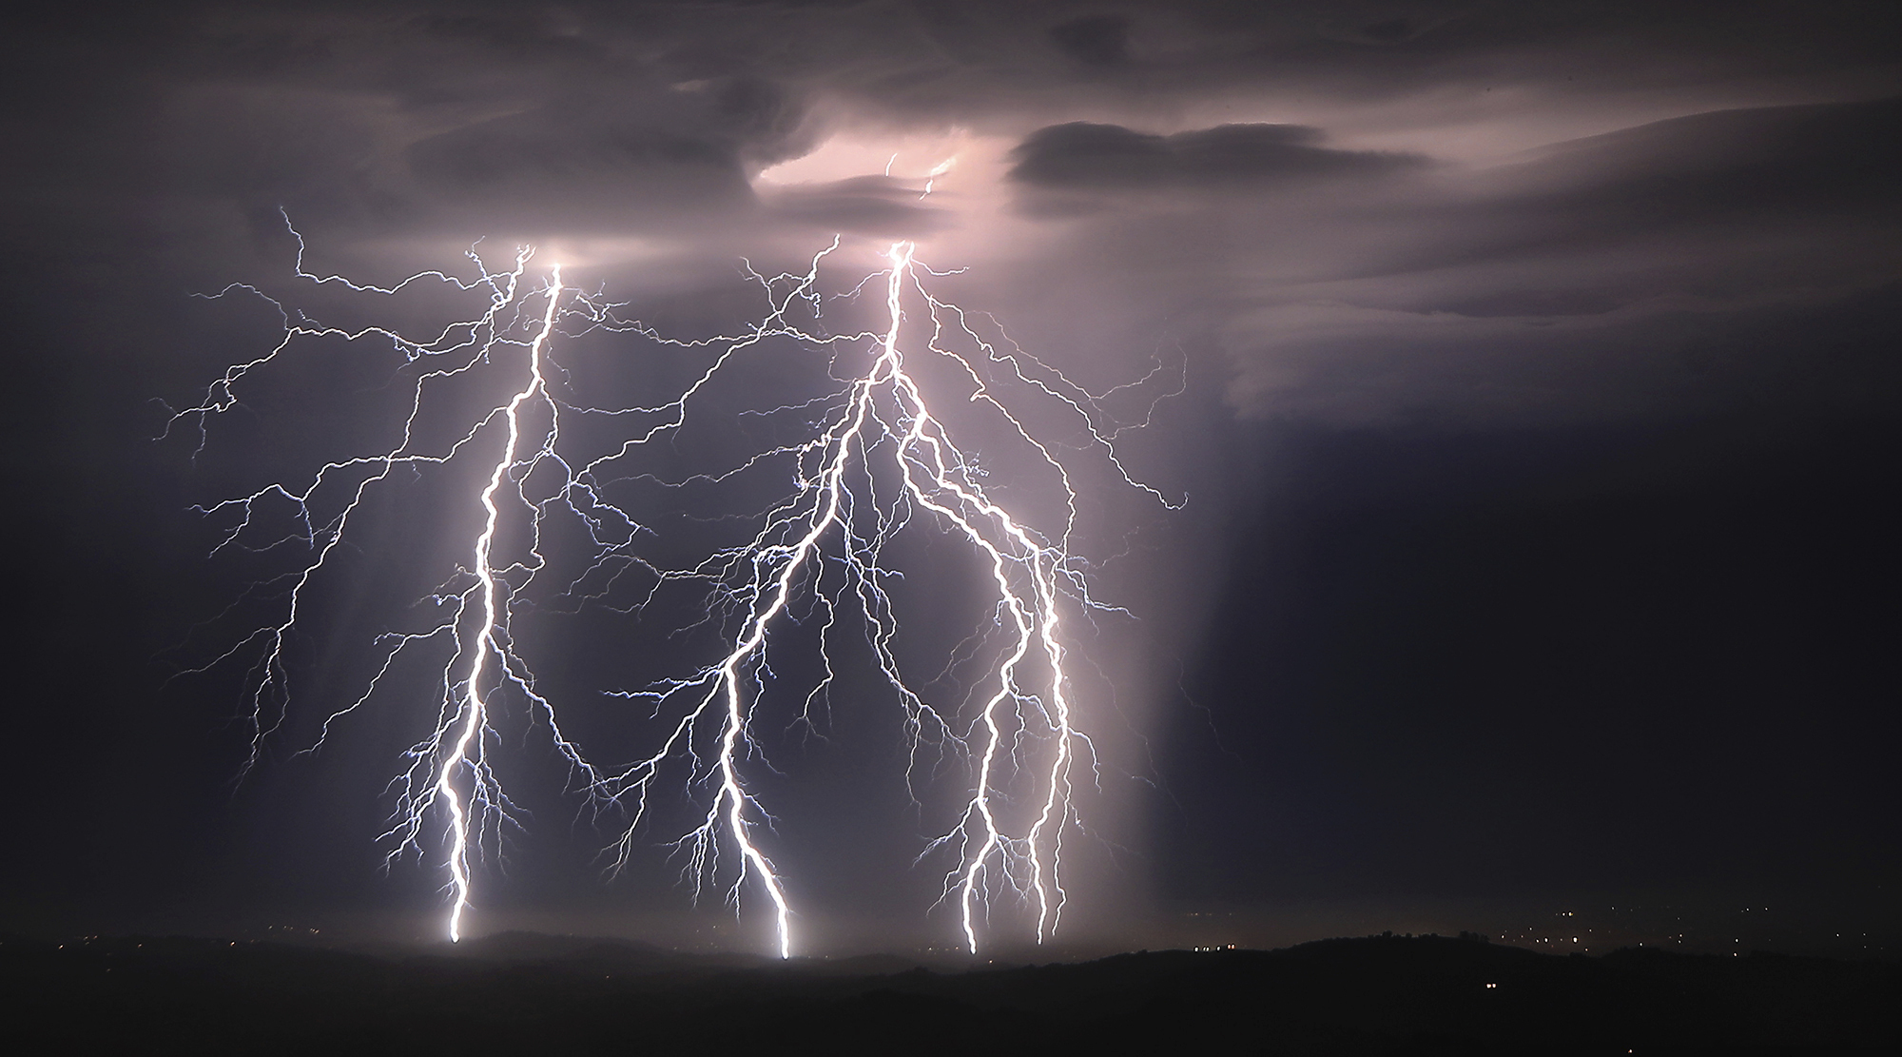
Reflect on the cause and effect of acid deposition by the actions of humans
Nitrogen oxides, NO & NO₂
When nitrogen oxides reacts with water in the atmosphere it forms nitric acid
Nitrogen oxides are produced by combustion engines and lightning strikes

Slide 13
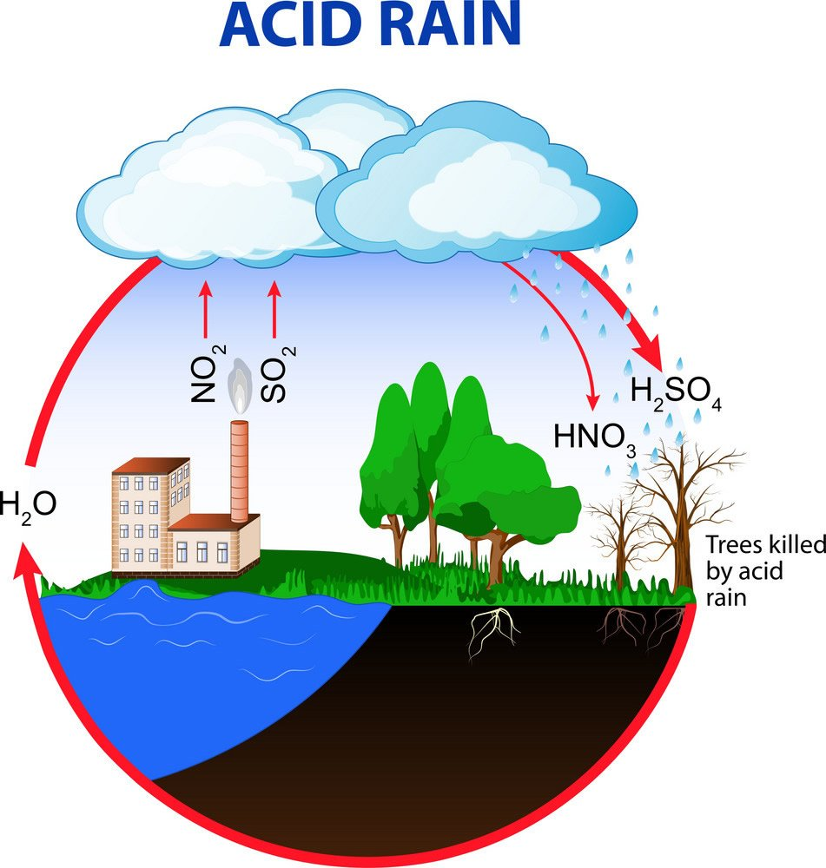
Reflect on the cause and effect of acid deposition by the actions of humans

Slide 14
Outline the impact of acid deposition and its effect of the water cycle on living things and infrastructure
Effects of Acid Deposition
Acid deposition can have dangerous effects on living systems and human infrastructure

Slide 15
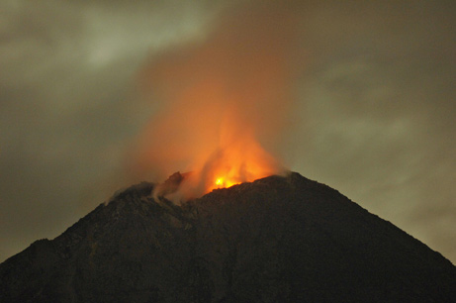
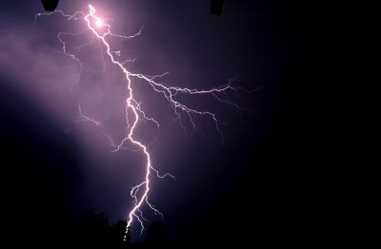
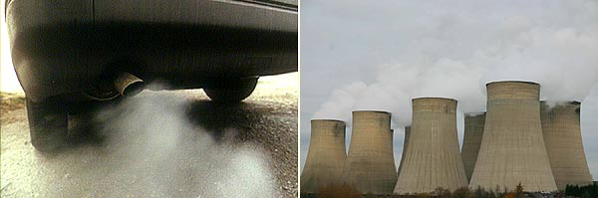
Where Does Acid Rain Come From?

Slide 16


Slide 17
True or False?
1. Acid rain is caused by the burning of fossil fuels.
2. Acid rain has a pH of 6.
3. Changing from a pH of 6 to 3 increases acidity by 2 times.
4. Sulfuric acid is produced when fossil fuels containing sulfur are burned.
5. Sulfuric acid dissolves in rainwater to form sulfur trioxide.

Slide 18
True or False?
6. Nitric acid is produced when nitrogen and oxygen react in the cylinders of motor vehicles.
7. Acid rain can neutralize alkaline soils.
8. Acid rain can cause damage when it falls on neutral or acidic soils.
9. Enzymes are unable to function in acidic conditions.
10. Acid rain can wash essential metals deep into the subsoil away from plant roots.

Slide 19
Task: 6a What is Acid Rain?
Complete the worksheet.

Slide 20
Task: 6b Acid Rain Info Sheet or
6b Environment acid rain fact sheet
Read one of the pdfs, writing your own notes as you go.

Slide 21

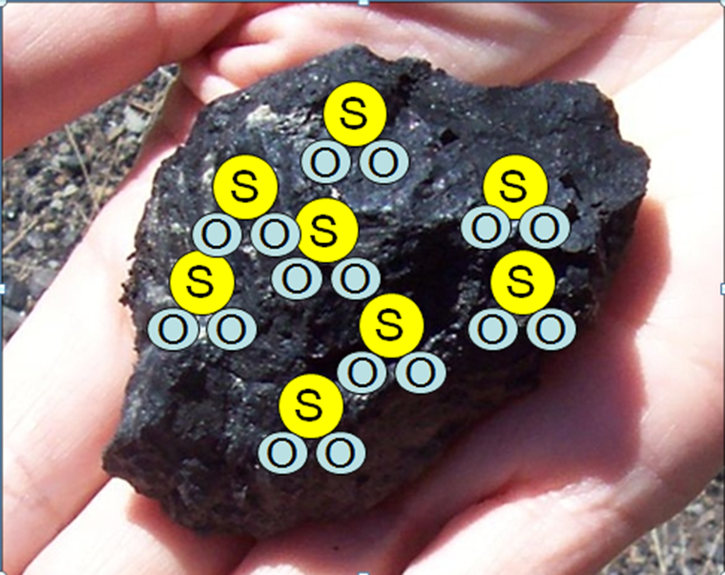
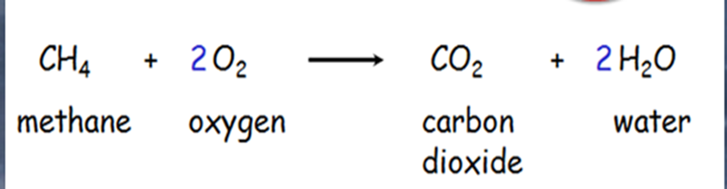
ACID RAIN
Rain is naturally slightly acidic (it contains carbon dioxide)
When water vapour is combined with certain pollution it makes the rain more acidic.
Where does the sulphur dioxide come from?

Slide 22
EQUATIONS
Sulphur dioxide and water form sulphurous acid (H₂SO₃) SO₂(g) + H₂O(l) → H₂SO₃(aq)
Some oxides of nitrogen, like nitrogen dioxide (NO₂), react with water to form nitrous acid (HNO₂) and nitric acid (HNO₃) 2NO₂(g) + H₂O(l) → HNO₂(aq) + HNO₃(aq)
Carbon dioxide in the air can dissolve in rain water to form carbonic acid, (H₂CO₃).
CO₂ + H₂O → H₂CO₃

Slide 23
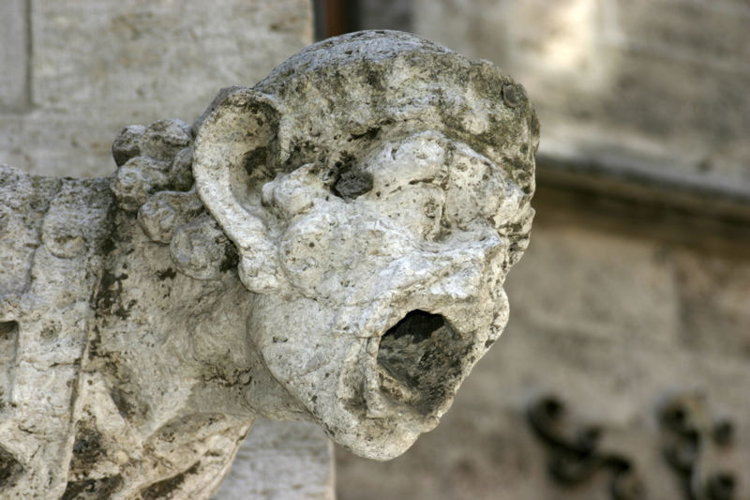
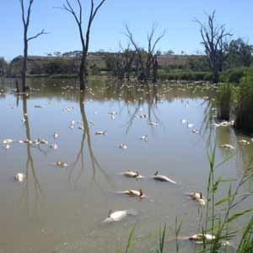
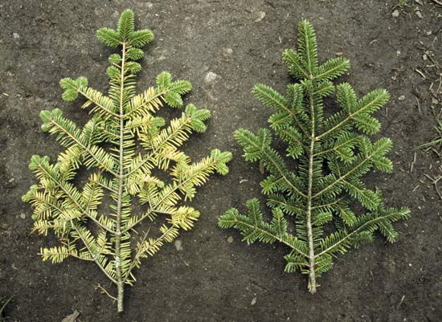
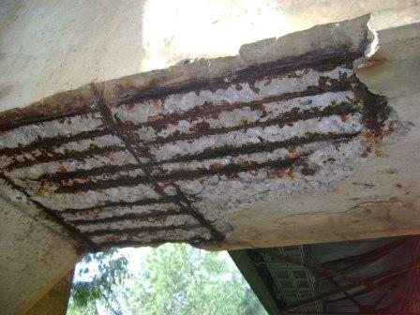
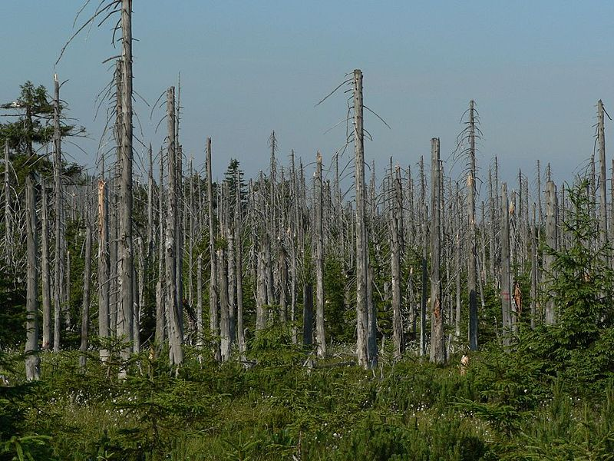

Slide 24
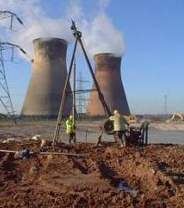
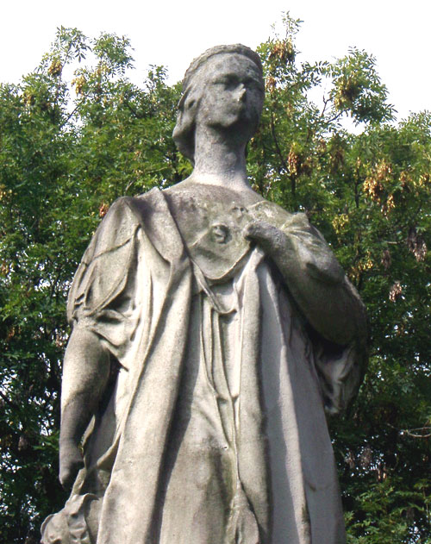
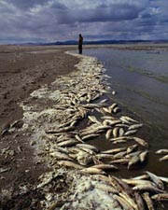
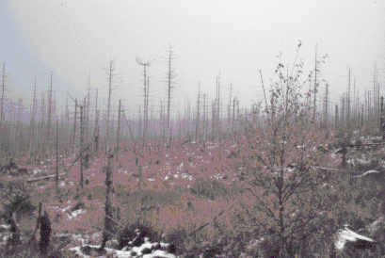
EFFECTS
Buildings and precious stone objects are weathered away as the stone reacts with the acid
When soil is contaminated, crop production drops
Acids pollute water which leads to fish death. Drinking water is contaminated.
These trees have been killed by acidic soil and waterways

Slide 25
Task: 6c Acid Deposition Example
Choose one of the four topics to research online. Find a real world example and prepare a slide in which you provide all relevant details.
Effect of Acid Deposition on Limestone Buildings
Effect of Acid Deposition on Metal Structures
Effect of Acid Deposition on Plants & Trees
Effect of Acid Deposition on Aquatic Life

Slide 26
Are you now able to….
Explain acid rain and its impacts on organisms, rocks and metals.

